Slide 1




Angular
Basics concepts
Jordi Serra Gonzalez
http://www.linkedin.com/in/jordi-serra-gonzalez/

Slide 2
Introduction
Architecture
Create your first Angular App
Template fundamentals
Component architecture
Services, http, Observables and Promises
Template driven forms – validation
Routing
Jordi Serra Gonzalez
http://www.linkedin.com/in/jordi-serra-gonzalez/

Slide 3
Introduction
Jordi Serra Gonzalez
http://www.linkedin.com/in/jordi-serra-gonzalez/

Slide 4
Introduction
New syntax
June 1997
ECMAScript 1
June 1998
ECMAScript 2
December 1999
ECMAScript 3
December 2009
ECMAScript 5
ES5
June 2015
ECMAScript 6
ES6/ES2015
June 2016
ECMAScript 7
ES7/ES2016
June 2017
ECMAScript 8
Jordi Serra Gonzalez
http://www.linkedin.com/in/jordi-serra-gonzalez/

Slide 5
Introduction
October 2012
TypeScript
March2005
Dojo
August 2006
jQuery
March 2007
Mootools
October 2010
BackboneJS
October 2010
AngularJS
March 2013
ReactJS
October 2015
Vuejs
September 2016
Angular
Jordi Serra Gonzalez
http://www.linkedin.com/in/jordi-serra-gonzalez/

Slide 6
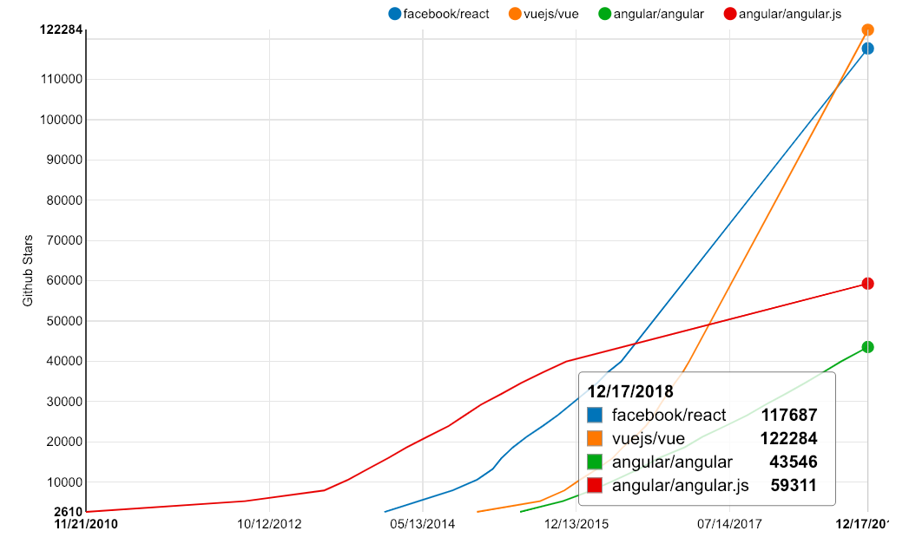
Introduction
Jordi Serra Gonzalez
http://www.linkedin.com/in/jordi-serra-gonzalez/

Slide 7
Architecture
Jordi Serra Gonzalez
http://www.linkedin.com/in/jordi-serra-gonzalez/

Slide 8
2. Architecture
Modules
Components
Directives
Routing
Services
Pipes
Jordi Serra Gonzalez
http://www.linkedin.com/in/jordi-serra-gonzalez/
Notes:
The typical architecture of an angular application is made up of these five building blocks

Slide 9
2. Architecture
Modules
<>
Building blocks that contain routes, components, services and more.
Jordi Serra Gonzalez
http://www.linkedin.com/in/jordi-serra-gonzalez/
Notes:
A module is a main building block of an angular application so we can have multiple modules, we can have a single module, we can have modules that deepens on other modules. Therefore, a module is a building block that can contain specific components like featured components, a service to call a backend or a route to know where to navigate on a specific path.

Slide 10
2. Architecture
Search
Chat
Inbox
Jordi Serra Gonzalez
http://www.linkedin.com/in/jordi-serra-gonzalez/
Notes:
Each of these can be a module that contain specific components and services for a purpose.

Slide 11
2. Architecture
Components
<>
Contains a template, data and logic, forming part of a DOM tree.
Jordi Serra Gonzalez
http://www.linkedin.com/in/jordi-serra-gonzalez/

Slide 12
2. Architecture
<>
<>
<>
<>
<>
<>
<>
Jordi Serra Gonzalez
http://www.linkedin.com/in/jordi-serra-gonzalez/
Notes:
A component is a high level DOM tree node which will then create subtree nodes. These is an example of how our node tree would look like. Each component then can run html code inside and the logic to manage data bindings on it. This is what we know as “Component Architecture”

Slide 13
2. Architecture
Directive
<>
Attach behaviour, extend or transform a particular element and its children.
Jordi Serra Gonzalez
http://www.linkedin.com/in/jordi-serra-gonzalez/
Notes:
A directive is something we can bind to an existing DOM element or just use it in a template on its own, which will extend or transform a particular element on its children.

Slide 14
2. Architecture
<>
<>
<>
<>
<>
<>
<>
<>
Jordi Serra Gonzalez
http://www.linkedin.com/in/jordi-serra-gonzalez/
Notes:
Now on the tree we can see a directive bound to a component. For example, this could be a search component and we could want to attach a directive to listen some particular event in order to perform an action over the element. Angular also provides several built-in directives that we will ease the development of applications.

Slide 15
2. Architecture
Services
<>
Data layer, logic that is not component related, such as API requests.
Jordi Serra Gonzalez
http://www.linkedin.com/in/jordi-serra-gonzalez/
Notes:
A service is basically our data layer. How do we get data into a component? A service will be the way to get and format the data in order to pass it in to a component. We can also use them to perform some particular logic non-component related or even listening internal events on the app, so we can then catch the message, format it and send it to the component.

Slide 16
2. Architecture
<>
<>
<>
<>
<>
<>
<>
<>
<>
Jordi Serra Gonzalez
http://www.linkedin.com/in/jordi-serra-gonzalez/
Notes:
Now on the tree we can see a service that it’s bound to a component.

Slide 17
2. Architecture
Routing
<>
Renders a component based on the URL state, drives navigation.
Jordi Serra Gonzalez
http://www.linkedin.com/in/jordi-serra-gonzalez/
Notes:
Routing drives the navigation for our application.

Slide 18
2. Architecture
<>
<>
<>
<>
<>
<>
<>
<>
<>
Jordi Serra Gonzalez
http://www.linkedin.com/in/jordi-serra-gonzalez/
Notes:
Now on the tree we can see a pink component, this is just a normal component but we might want to change the child component based on the URL. For example, for the URL /inbox we might want to render the left component and for /service the right component, this routing component will decide which children needs to be call and in this way, we are able to render dynamic components.

Slide 19
Create your first Angular Application
Jordi Serra Gonzalez
http://www.linkedin.com/in/jordi-serra-gonzalez/

Slide 20


3. Create your first Angular Application
Angular Language features: Link here
VSCode Icons: Link here
Jordi Serra Gonzalez
http://www.linkedin.com/in/jordi-serra-gonzalez/

Slide 21
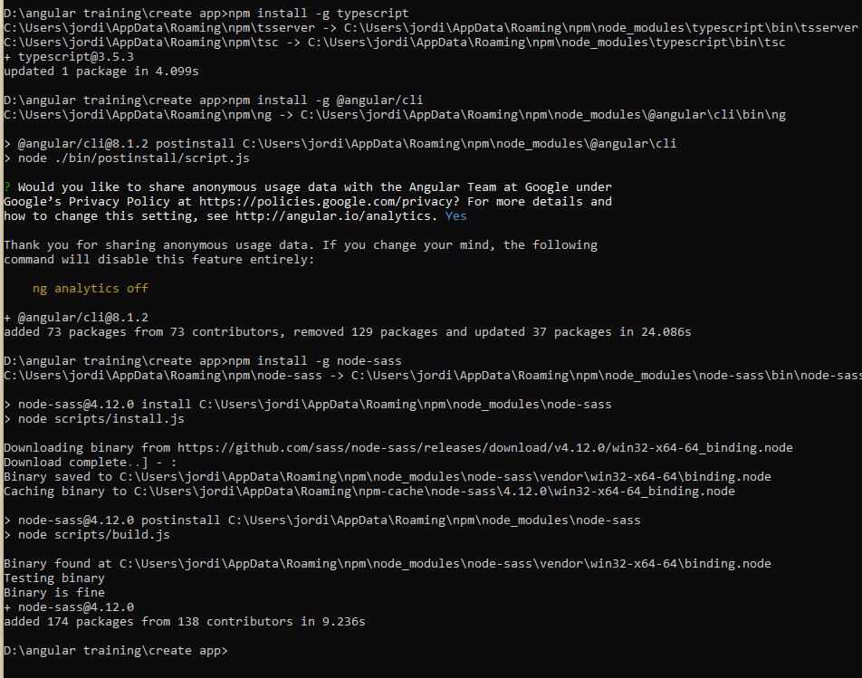
3. Create your first Angular Application
Jordi Serra Gonzalez
http://www.linkedin.com/in/jordi-serra-gonzalez/
Notes:
npm install –g typescript
npm install –g @angular/cli

Slide 22
3. Create your first Angular Application
Jordi Serra Gonzalez
http://www.linkedin.com/in/jordi-serra-gonzalez/
Notes:
npm install –g node-sass

Slide 23
3. Create your first Angular Application
$ ng new angular-basics-app
$ cd angular-basics-app
$ ng serve
Jordi Serra Gonzalez
http://www.linkedin.com/in/jordi-serra-gonzalez/

Slide 24
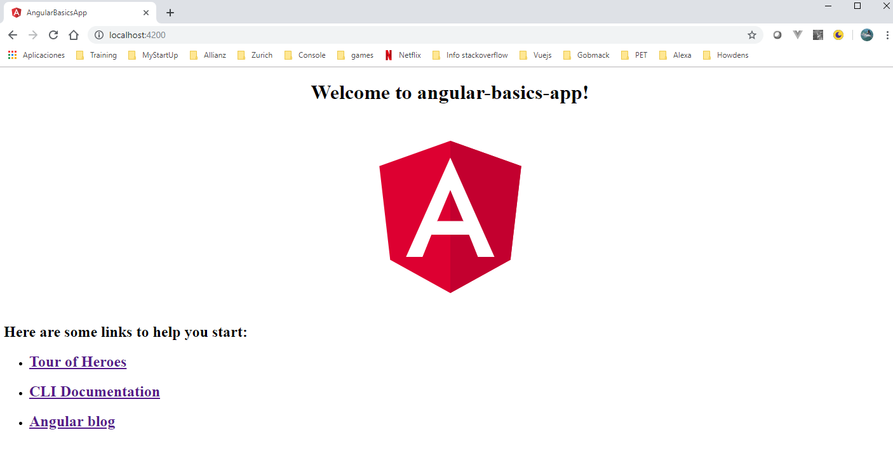
3. Create your first Angular Application
Jordi Serra Gonzalez
http://www.linkedin.com/in/jordi-serra-gonzalez/

Slide 25
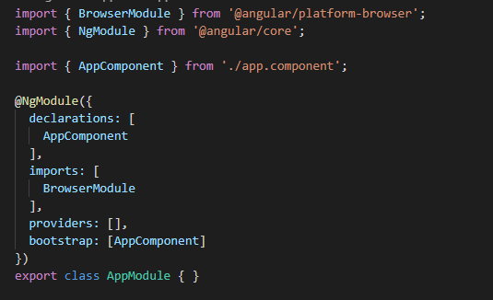
3. Create your first Angular Application
Main @ngModule
Jordi Serra Gonzalez
http://www.linkedin.com/in/jordi-serra-gonzalez/
Notes:
Declarations: declare components, pipes and directives
Imports: Import other modules
Providers: declare services
Bootstrap: unique, main component

Slide 26
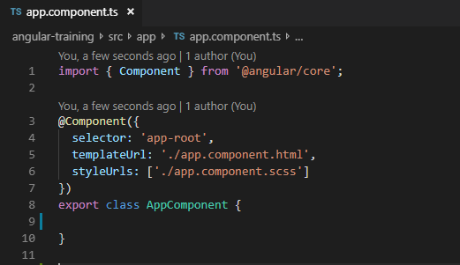
3. Create your first Angular Application
Main @Component
This component it’s used in the bootstrap option in @ngModule
Jordi Serra Gonzalez
http://www.linkedin.com/in/jordi-serra-gonzalez/
Notes:
@Component: declaration of Component
Selector: selector that identifies this directive in a template
templateUrl: html url relative
styleUrls: scss url relative

Slide 27
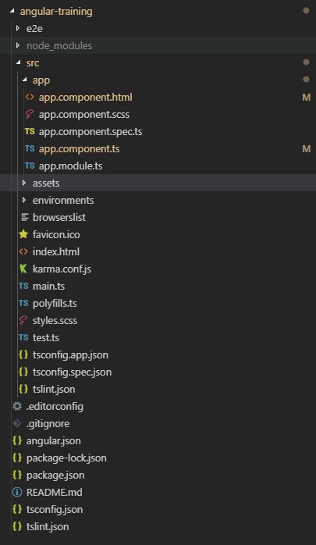
3. Create your first Angular Application
App folder contains all components of the project.
Assets contains images and json statics.
Environments contains configuration for each different environment
Jordi Serra Gonzalez
http://www.linkedin.com/in/jordi-serra-gonzalez/

Slide 28
Template fundamentals
Jordi Serra Gonzalez
http://www.linkedin.com/in/jordi-serra-gonzalez/

Slide 29
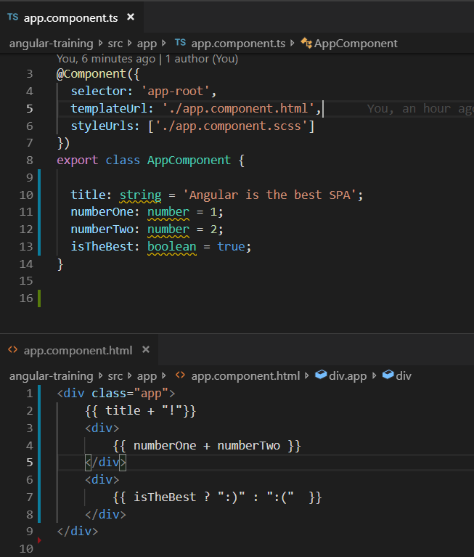
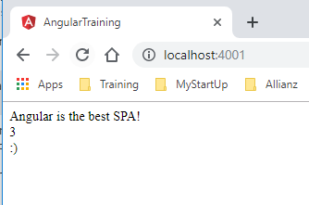
4. Template fundamentals
Jordi Serra Gonzalez
http://www.linkedin.com/in/jordi-serra-gonzalez/
Notes:
We can see 3 example here:
Concatenate two string and display the result
Sum of 2 numbers (Math expression)
A ternary operator expression
We can see the result at the right

Slide 30
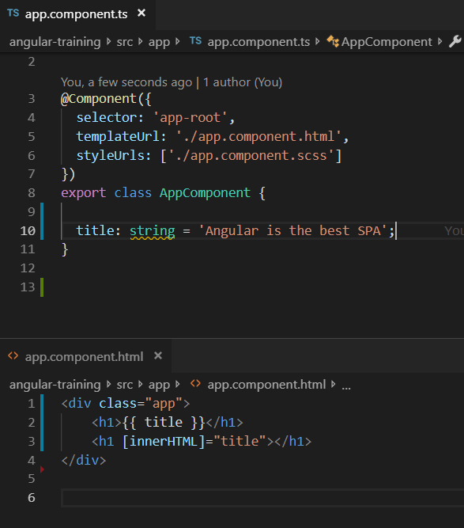
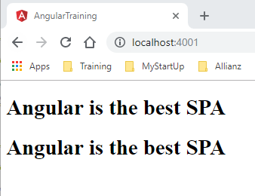
4. Template fundamentals
Jordi Serra Gonzalez
http://www.linkedin.com/in/jordi-serra-gonzalez/
Notes:
Property binding is how we can pass data from a component class into a template by binding it to a particular element.
The curly braces are something called sugar syntax. It is an easier way to do something that looks cleaner.
Let’s wrap the title with an h1 tag. Sugar syntax will automatically take the value an put it inside the h1. What is really doing is set the innerHTML of the element to the value we pass in.
The equivalent would be something similar to what we have here. Please note that we use brackets notation [] wrapping the innerHTML attribute, that’s the way we can bind an attribute of an element with a variable inside the class. That’s what we call one-way data flow syntax. The data goes from the class to the template and is displayed.

Slide 31
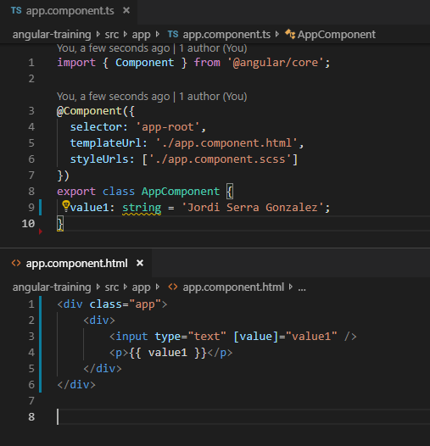
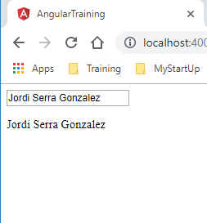
4. Template fundamentals
Jordi Serra Gonzalez
http://www.linkedin.com/in/jordi-serra-gonzalez/
Notes:
Last example of the one-way binding property will be an input, something that the user can change and modify.
For the input the steps are the same, we want to bind the attribute value of the element <input> to the property name of the class, a property that we’re going to declare and initialize right now.
Please note that the value of the property won’t change even if the user interacts with the input, this is a one-way binding. To demonstrate this, we will display the name as well and check out the result

Slide 32
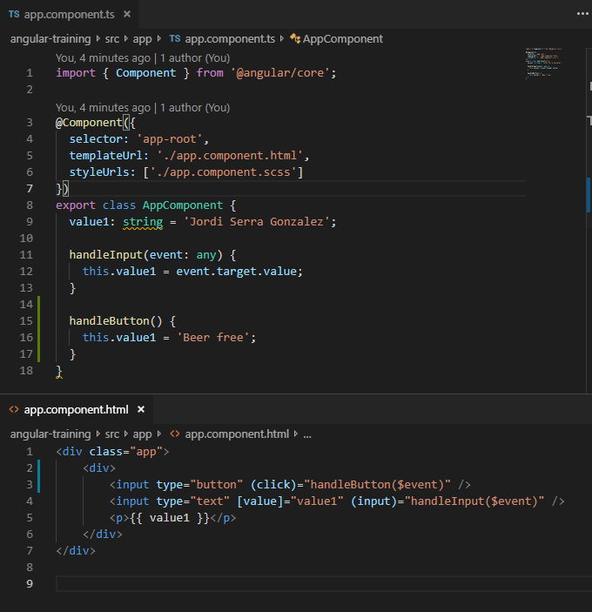
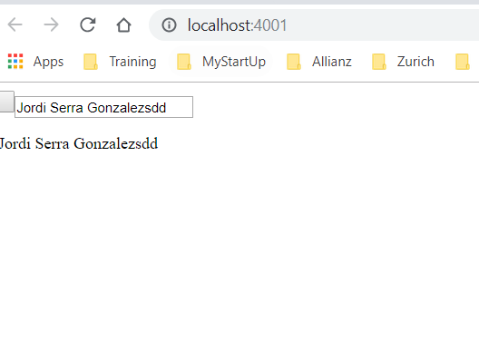
4. Template fundamentals
Jordi Serra Gonzalez
http://www.linkedin.com/in/jordi-serra-gonzalez/

Slide 33
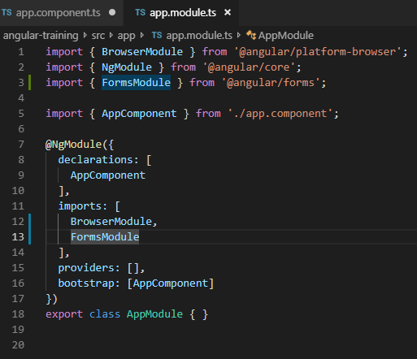
4. Template fundamentals
Jordi Serra Gonzalez
http://www.linkedin.com/in/jordi-serra-gonzalez/

Slide 34
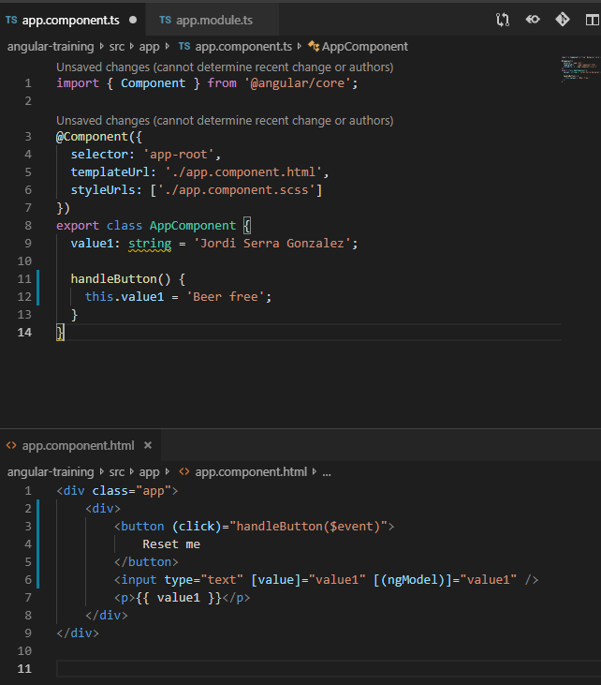
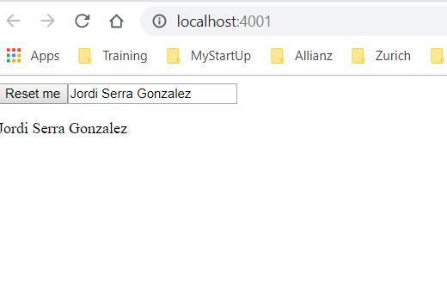
4. Template fundamentals
Jordi Serra Gonzalez
http://www.linkedin.com/in/jordi-serra-gonzalez/

Slide 35
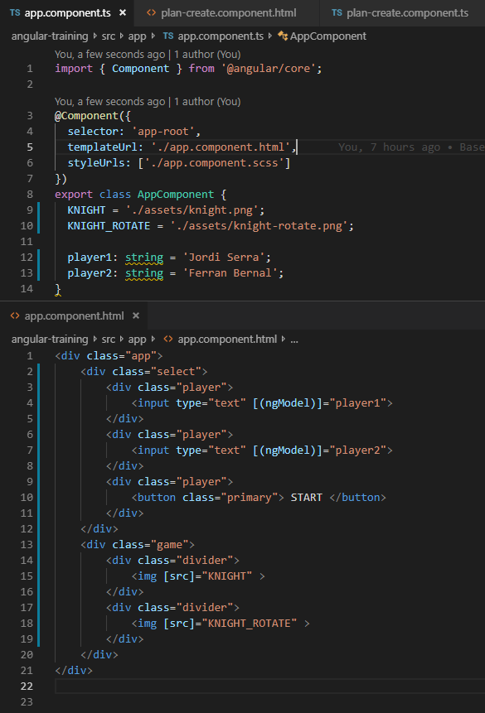
4. Template fundamentals
Jordi Serra Gonzalez
http://www.linkedin.com/in/jordi-serra-gonzalez/

Slide 36
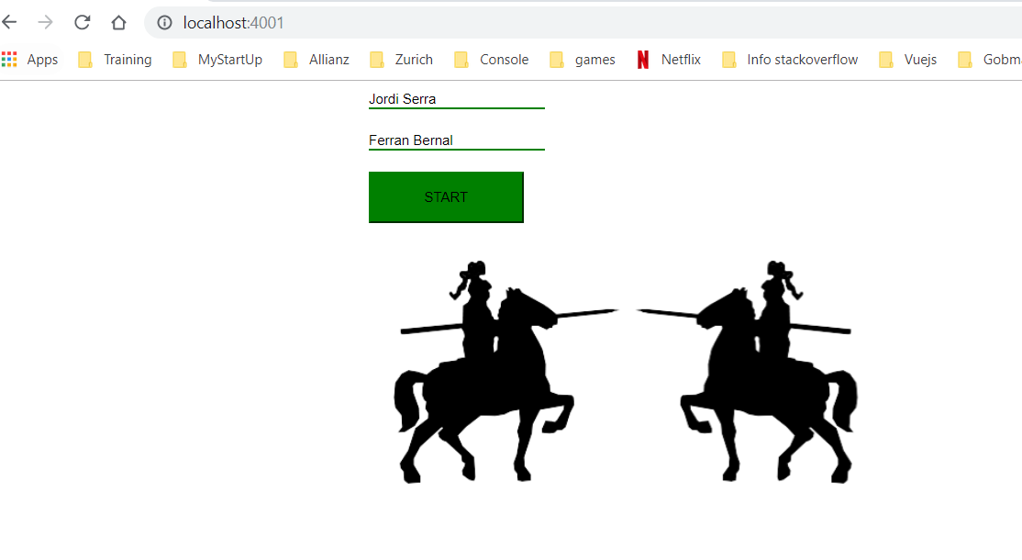
4. Template fundamentals
Jordi Serra Gonzalez
http://www.linkedin.com/in/jordi-serra-gonzalez/

Slide 37
4. Template fundamentals
Jordi Serra Gonzalez
http://www.linkedin.com/in/jordi-serra-gonzalez/

